Slide 1
My View on Core ML
Dustin Jia
dustinjia@gmail.com

Slide 2
What is Core ML
My Core ML Project
My view on Core ML

Slide 3
What is Core ML
Machine Learning
NVIDIA defines machine learning like this: "Machine Learning at its most basic is the practice of using algorithms to parse data, learn from it, and then make a determination or prediction about something in the world."
Deep Learning
Deep learning is a class of machine learning algorithms that: use a cascade of many layers of nonlinear processing units for feature extraction and transformation.

Slide 4
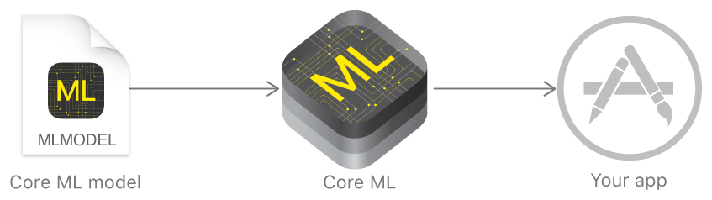
Core ML
A tool that helps us integrate machine learning models into our app.

Slide 5
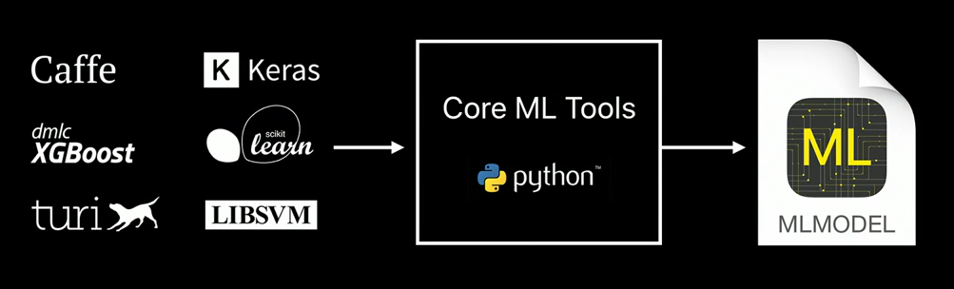
Core ML Models
1. Apple’s Models
https://developer.apple.com/machine-learning/
2. Custom Models
TensorFlow? TensorFlow Lite

Slide 6
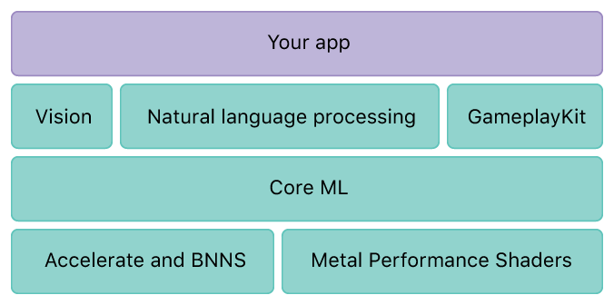
System Structure
CPU
GPU

Slide 7
My Core ML Project
Due to our company’s confidential policy, let’s simplify the requirement like this:
Recognize double-knock intention on the phone.

Slide 8
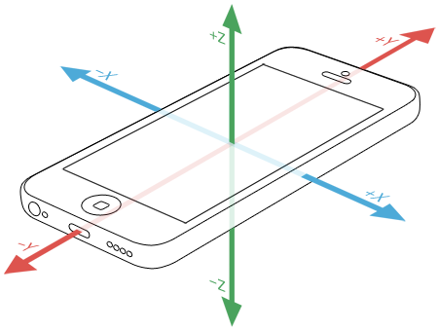
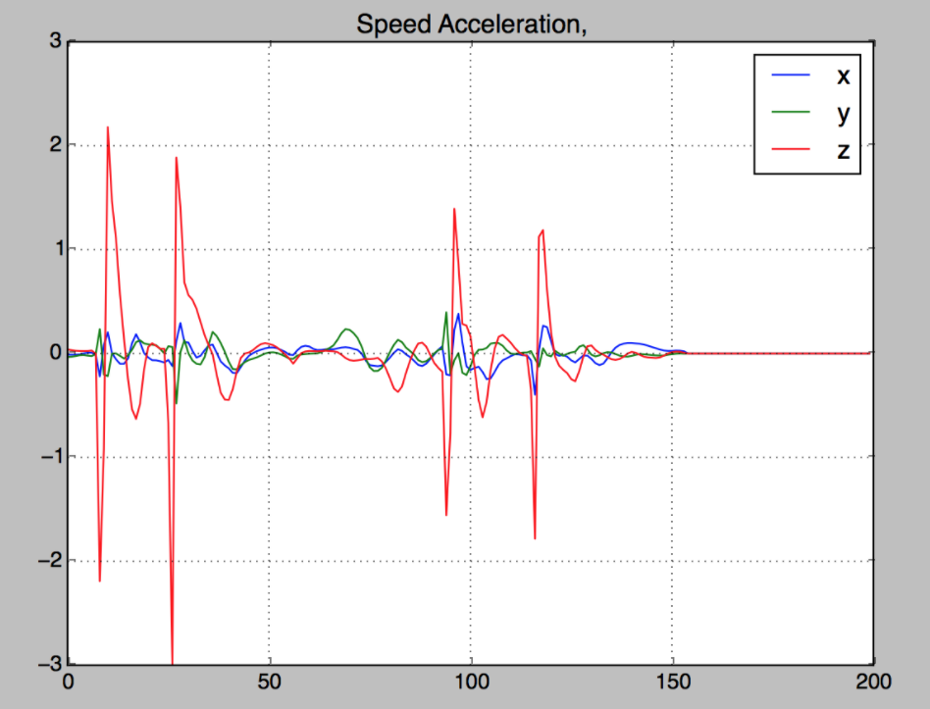
Data Collection
Accelerometer
Signal Processing
ERROR CASE: False Positive & False Negative

Slide 9
Challenge
Signals have peaky features,
but “looks” differently
double knock, static
double knock while walking
(a)
(b)
shake
phone
drop
phone on soft surface
(c)
(d)

Slide 10
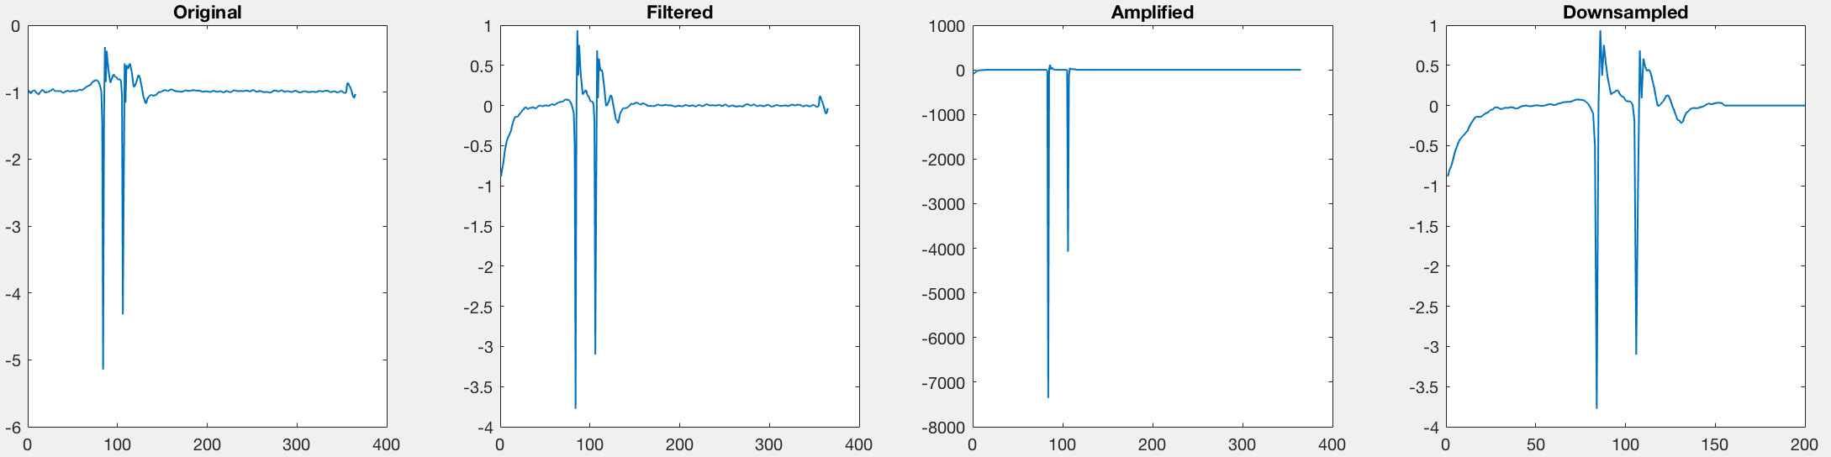
Digital Signal Processing (DSP)
Step 1
Original Signal
High-Pass Filter
Heighten Signatures
Judgement ?
Step 2
Unlock / Ignore
Core ML Model
Up / Down Sampling

Slide 11


Machine Learning
$$√$$
2 knock
Not 2 knock
Algorithm
$$×$$
Algorithm: Convolutional Neural Network (CNN) model (supervise learning)
Why CNN:
Can capture the shape signatures of the signals.
Can differentiate between various gestures.

Slide 12


CNN Model Structure
$$√$$
2 knock
Not 2 knock
$$×$$
With collected data, model achieved overall 95% accuracy in differentiating two groups of gestures.

Slide 13
My view on Core ML
Pros
Easy to integrate machine learning models into OS app.
Good performance, process models fast.
Apple provides some stable models that help us dive into machine learning world easier.
Comes with a handy converter tool that supports several different training packages. (Keras, Caffe, etc.)
Supports deep learning, logistic regression, decision trees, and other “classic” machine learning models.

Slide 14
Cons
Doesn’t support all types of models. If the model you trained isn’t supported by Core ML, then you can’t use Core ML.
The input and output format isn’t very straightforward to understand.
Hard to debug. The LLVM debugger doesn’t work on the Core ML model file. Meaning if your model doesn’t give result or the result isn’t what you expected, it wouldn’t be very easy to figure out whether it was caused by the input data format or by the model itself, or even by the model conversion procedure.
Doesn’t support federated learning or other self-learning mechanisms.

Slide 15
Some Helpful Third-Party Libraries
CoreMLHelpers (https://github.com/hollance/CoreMLHelpers)
This is a collection of types and functions that make it a little easier to work with Core ML in Swift.
Surge (https://github.com/mattt/Surge)
Surge is a Swift library that uses the Accelerate framework to provide high-performance functions for matrix math, digital signal processing, and image manipulation.

